Slide 1
COA COURSE PROJECT (2019-2020) IMPLEMENTING LFU(LEAST FREQUENTLY USED) CACHE REPLACEMENT ALGORITHM using Python..
Members:
1)Himanshu Pandey(20)
2)Nishant Bhat(41)
3)Shyam Kawale(27)
4)Abhijit Gawai(18)
5)Bhargav Pawar(46)

Slide 2
INTRODUCTION:
Least Frequently Used (LFU) is a type of cache algorithm used to manage memory within a computer. The standard characteristics of this method involve the system keeping track of the number of times a block is referenced in memory.
LFU is sometimes combined with a Least Recently Used algorithm and called LRFU.

Slide 3
Need for the project:
When the cache is full and requires more room the system will purge the item with the lowest reference frequency.
When the memory is fully filled then we have to replace the old data with new data.
So we are going to implement LFU and LRU.

Slide 4
Process:
First we will track the frequency of every data input in cache.
For removing data we will find the least frequent data, then among them, if there are many, we will find the least recent and then replace it with the new data.
And then at last we will update our tracking system.

Slide 5
SOURCE CODE:
arr=[1024 for i in range(1024)]
rec=[]
def ip(data):
global rec
try:
rec.remove(data)
except:
z=1
try:
if(data<0) and (data>1023):
raise IndexError
rec.append(data)
if(arr[data]==1024):
arr[data]=1
else:
arr[data]+=1
except IndexError:
print("enter a valid input!!")
def delete():
k=arr.index(min(arr))
rec.remove(k)
arr[k]=1024
def display():
i=0;
print("data :: frequency")
l=len(rec)
while(i<l):
st=str(rec[i])
s=" "
print(st.ljust(6," "),"::",s.rjust(9," "),arr[rec[i]])
i+=1
print("eneter a integer for input or type del to delete or disp for display or exit to exit")
while(True):
char=input()
try:
ch=int(char)
ip(ch)
except:
if(char=="del"):
delete();
elif(char=="disp"):
display()
elif(char=="exit"):
break
else:
print("enter a valid input!!")

Slide 6
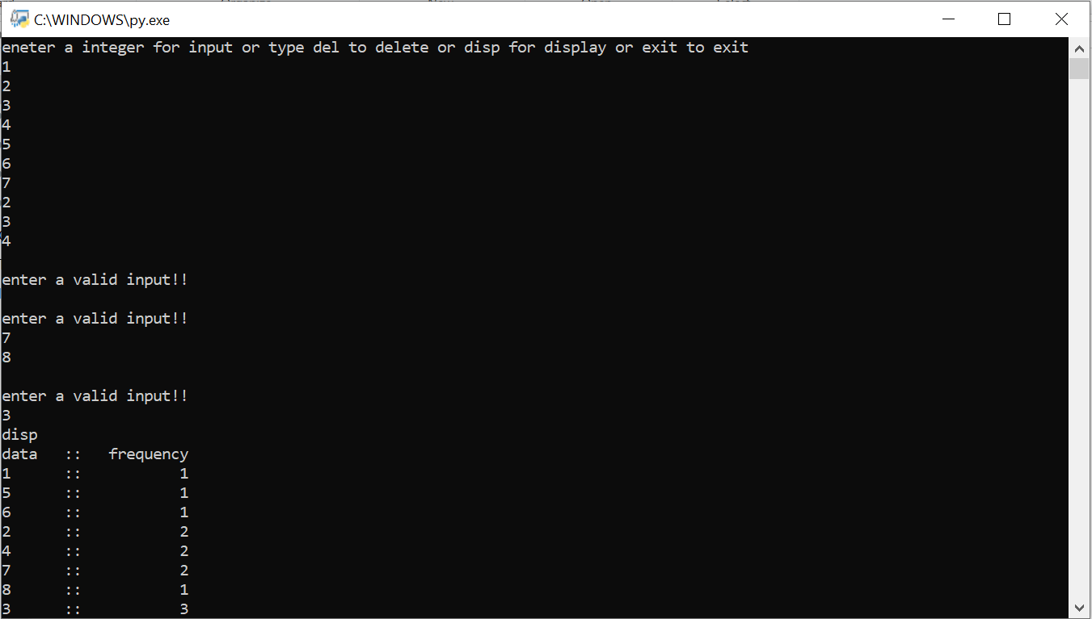
Output:

Slide 7
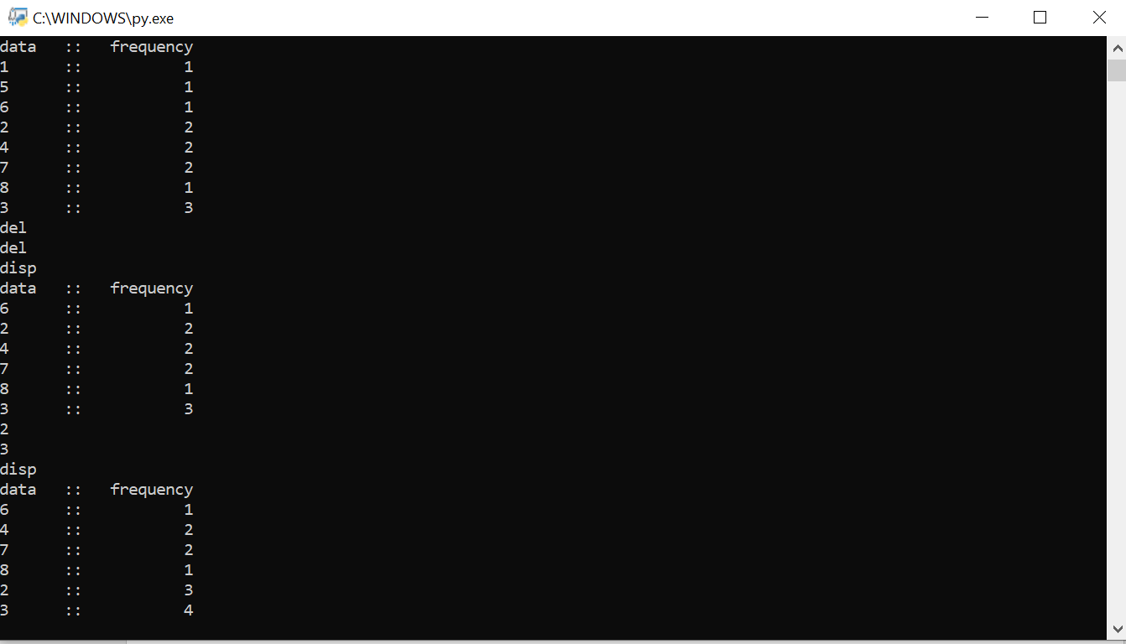

Slide 8
THANK YOU..

